Slide 1
LogoScript-MPIS20 Compiler

Slide 2
Background
We have done a interpreted language called LogoScript
Stack based VM
We are coding 20-instruction MIPS CPU
We need something to simplify coding for our MIPS20 CPU

Slide 3
Writing a Compiler
2 weeks before final exam
I have wrote a “translator” from the LogoScript stack-based VM to MIPS20
Rather simple
Without any optimization
Produce rather large code
Use less than 5 registers (almost everything are done on the stack)

Slide 4
Writing a program
A+B Problem
function main() {
while(1) {
`Read an integer from port 0x40C0(mapped to switches)
d=in(0x40C0);
`Read another integer from port 0x40C4 (mapped to another set of switches)
e=in(0x40C4);
`Calculate d+e
f=d+e;
`Write the result to port 0x4080(mapped to LEDs)
out(0x4080,f);
}
}

Slide 5
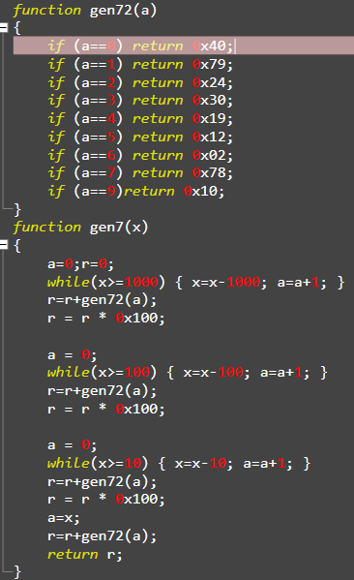
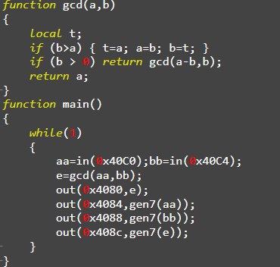
Writing a more complex program

Slide 6
Several notes
All variable types are 32-bit integer(same as CPU register)
All globals do not need definition
Support + - * but no /
You may define local vars using the local keyword
All programs runs from main() and the CPU blocks after finished running
Default return value is 0
No branch delay slot

Slide 7

Compiling a program
Usage : Compiler [script.txt] [CodeMemSize] [DataMemSize]
After that you will have:
asm.txt : Raw asm code
sc_datamem.mif: Compiled data memory
sc_instmem.mif: Compiled instruction memory

Slide 8
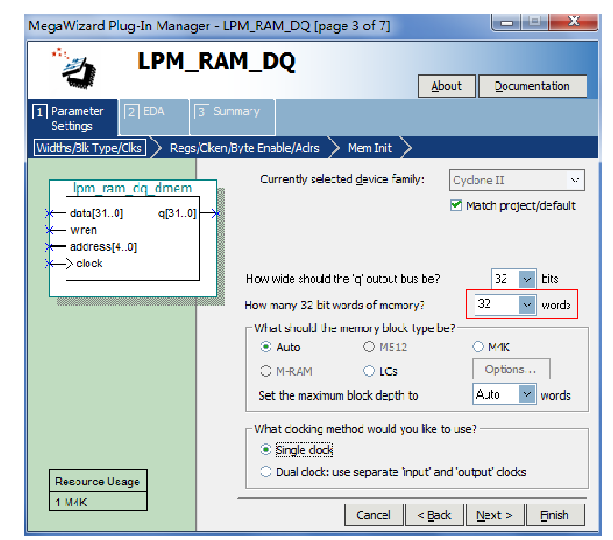
Notice
You MUST set the CodeMemSize and DataMemSize according to your design file

Slide 9
Github
https://github.com/ak48disk/mips

